Slide 1
Linux: Unit 3a

Slide 2
Advanced Linux Commands
grep – It can read just about any text, from another commands, or it can open and look through files directly.
What if:
You want to look for any file containing certain text
You want to look through the output of a command

Slide 3
grep
To search a file for a particular string, provide the string and filename as arguments:
grep 'some text' /etc/ssh/sshd_config
You may also redirect output from a command to grep using a pipe:
tail -f /var/log/apache/error.log | grep 'some text'

Slide 4

APT
The key to software that doesn’t come by default!
How to use:
apt install software
apt remove software

Slide 5
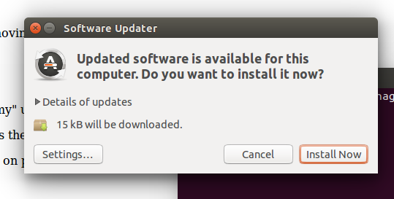
Configuring APT
Run the command update-manager and select settings

Slide 6
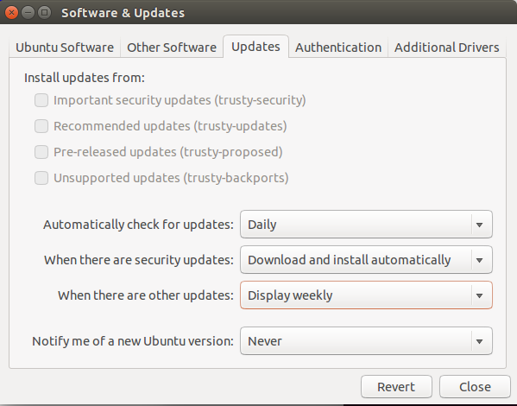

Slide 7
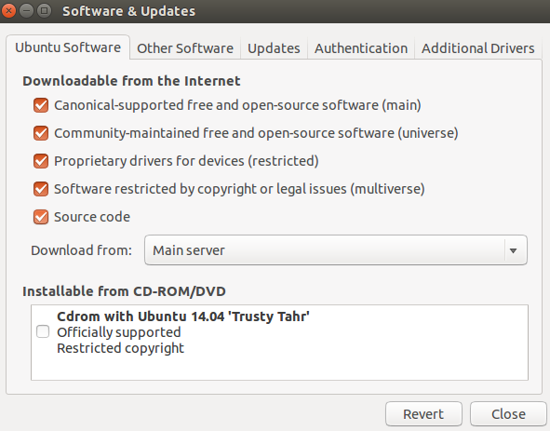

Slide 8
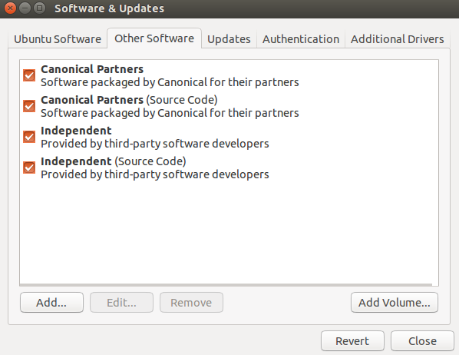

Slide 9
Updating…
After reconfiguring apt, you have to reload it with the following command
apt update
Upgrading is getting the newest version of software and it not the same as updates
apt upgrade

Slide 10
Recap
apt update
apt install package
apt remove package
apt purge package

